Slide 1
Hadoop Basics

Slide 2
Agenda
What is Hadoop
Hadoop basic architecture
What is MapReduce
MapReduce flow
Difference BW MR1 and MR2 (YARN)
Replication and rack awareness
Hadoop basic commands
Different file compressions and it’s tools
Q&A

Slide 3
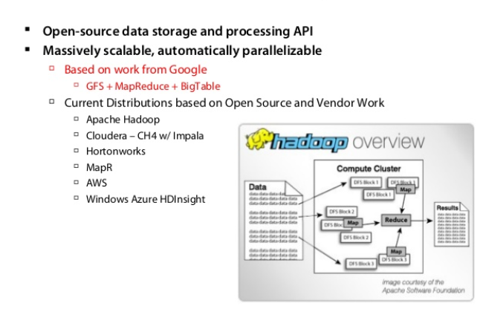
What is Hadoop?
Hadoop is an open source, Java-based programming framework that supports the processing and storage of extremely large data sets in a distributed computing environment. It is part of the Apache project sponsored by the Apache Software Foundation.

Slide 4
Hadoop Processes
Basically Hadoop processes can be start and stop multiple ways
1- start-all.sh and stop-all.sh
2- start.dfs.sh, stop.dfs.sh and start-yarn.sh, stop-yarn.sh
3- hadoop.daemon.sh start namenode/datanode and hadoop.daemon.sh stop namenode/datanode
When you start Hadoop below process will get start
NameNode
Secondary NameNode
Jobtracker
DataNode
TaskTracker

Slide 5
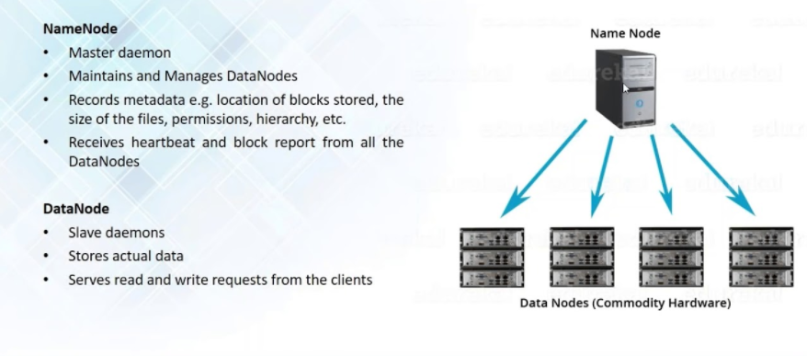
Name Node and Data Node

Slide 6
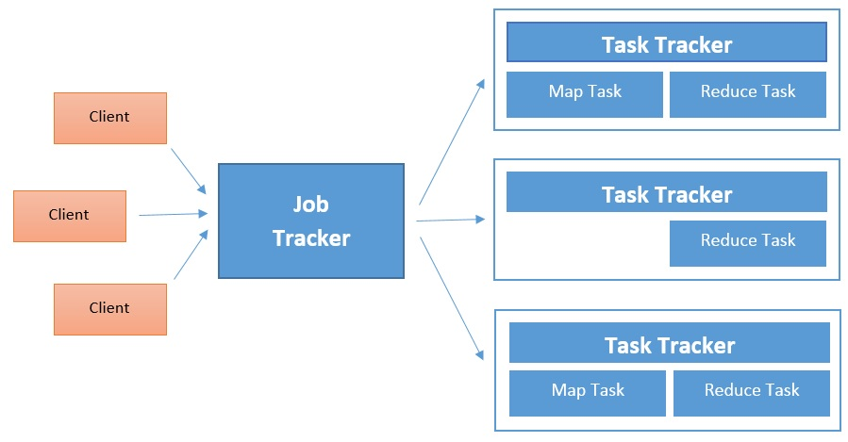
JobTracker and TaskTracker
JobTracker:
1. JobTracker process runs on a separate node and not usually on a DataNode.
2. JobTracker receives the requests for MapReduce execution from the client.
3. JobTracker talks to the NameNode to determine the location of the data.
4. JobTracker monitors the individual TaskTrackers and the submits back the overall status of the job back to the client.
Task Tracker:
TaskTracker runs on DataNode.
TaskTrackers will be assigned Mapper and Reducer tasks to execute by JobTracker.
TaskTracker will be in constant communication with the JobTracker signaling the progress of the task in execution.
When TT becomes unresponsive, JT will assign the task executed by the TT to another node.

Slide 7
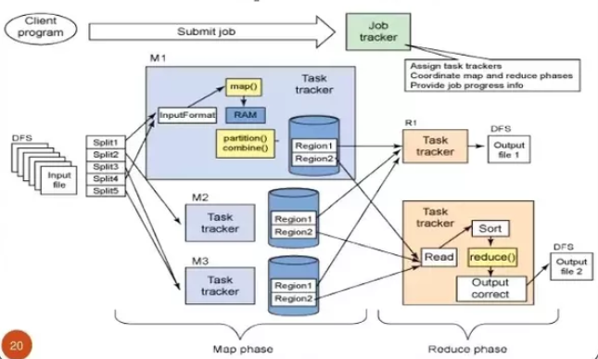
Hadoop Architecture
Hadoop is a master slave architecture
Masters are:
NameNode
Secindary NameNode
Job Tracker
Slaves are:
Data Node
Task Tracker

Slide 8
What is MapReduce?
The term MapReduce actually refers to two separate and distinct tasks that Hadoop programs perform.
The first is the map job, which takes a set of data and converts it into another set of data, where individual elements are broken down into tuples (key/value pairs).
The reduce job takes the output from a map as input and combines those data tuples into a smaller set of tuples. As the sequence of the name MapReduce implies, the reduce job is always performed after the map job.
MapReduce for data processing

Slide 9
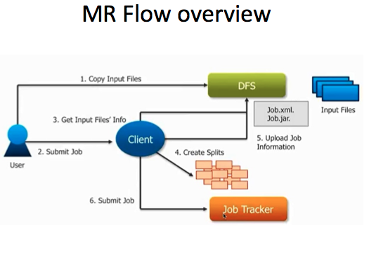
MapReduce Flow

Slide 10
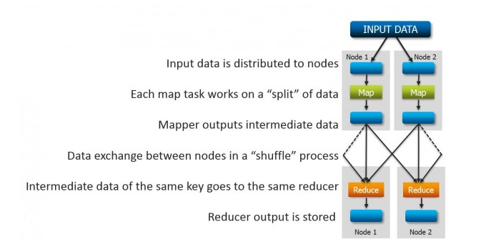
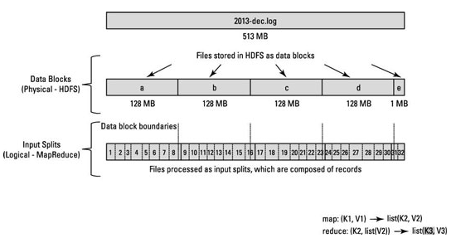
How Input data splits?
Input data splits
Case 1:
File Size 128 MB
Block size 64 MB
Split size 64 MB
Then:
2 Blocks &
2 Splits
Case 2:
File Size 128 MB
Block size 128 MB
Split size 64 MB
Then:
1 Blocks &
2 Splits
Case 3:
File Size 128 MB
Block size 64 MB
Split size 128 MB
2 Blocks merge
1 Split

Slide 11
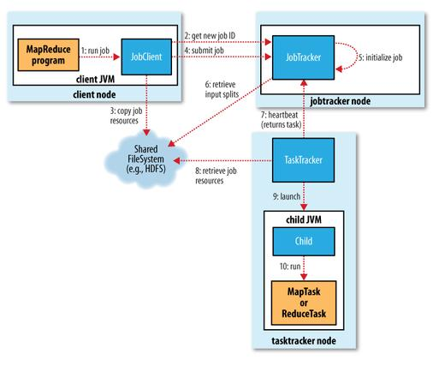
Anatomy of MapReduce
Job Client checks the input file and file size
then decides the how many input splits
Required. Also it copy 10 replications in it’s local files system.

Slide 12
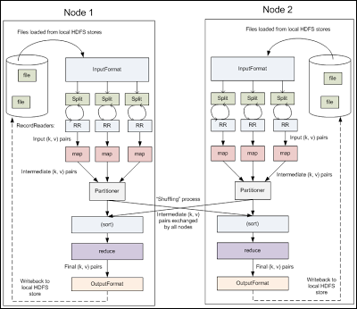
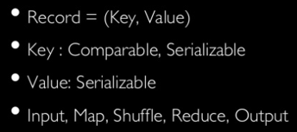
Input data processing flow
Different File input formats:
TextInputFormat
KeyValueTextInputFormat
SequenceFileInputFormat
SequenceFileAsTextInputFormat

Slide 13
Input format differences
1. TextInputFormat
It is the default InputFormat of MapReduce. TextInputFormat treats each line of each input file as a separate record and performs no parsing. This is useful for unformatted data or line-based records like log files.
Key – It is the byte offset of the beginning of the line within the file (not whole file just one split), so it will be unique if combined with the file name.
Value – It is the contents of the line, excluding line terminators.
2. KeyValueTextInputFormat
It is similar to TextInputFormat as it also treats each line of input as a separate record. While TextInputFormat treats entire line as the value, but the KeyValueTextInputFormat breaks the line itself into key and value by a tab character (‘/t’). Here Key is everything up to the tab character while the value is the remaining part of the line after tab character.
3. SequenceFileInputFormat
Hadoop SequenceFileInputFormat is an InputFormat which reads sequence files. Sequence files are binary files that stores sequences of binary key-value pairs. Sequence files are block-compressed and provide direct serialization and deserialization of several arbitrary data types (not just text). Here Key & Value both are user-defined.
4. SequenceFileAsTextInputFormat
Hadoop SequenceFileAsTextInputFormat is another form of SequenceFileInputFormat which converts the sequence file key values to Text objects. By calling ‘tostring()’ conversion is performed on the keys and values. This InputFormat makes sequence files suitable input for streaming.

Slide 14
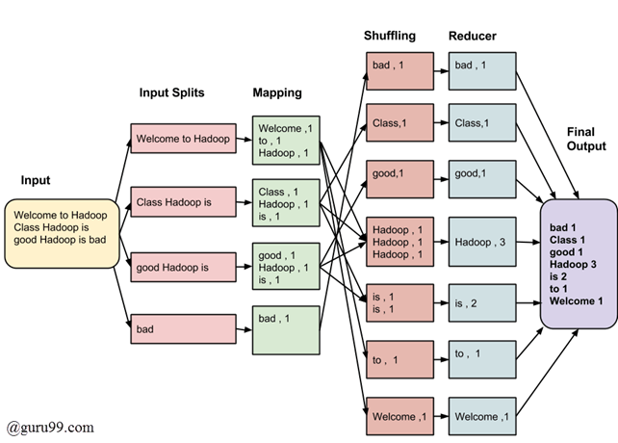
Ex: Process input and produce output

Slide 15
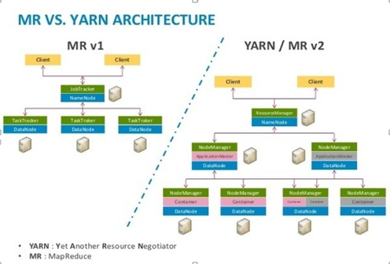
MR1 VS MR2 (YARN)

Slide 16
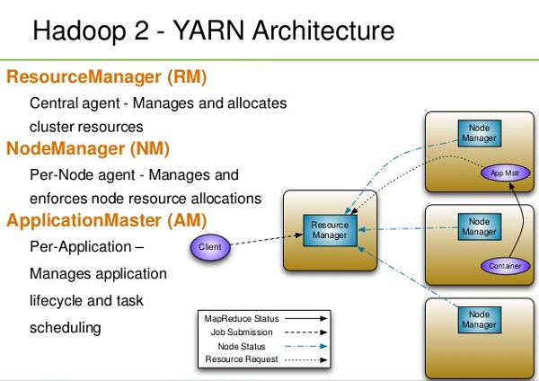
Hadoop 2 Architecture

Slide 17
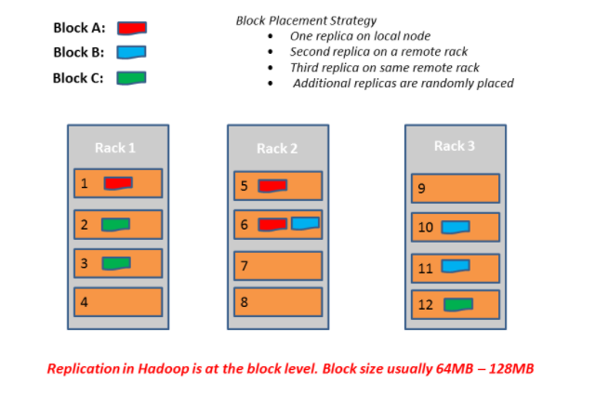
Replication and rack awareness

Slide 18
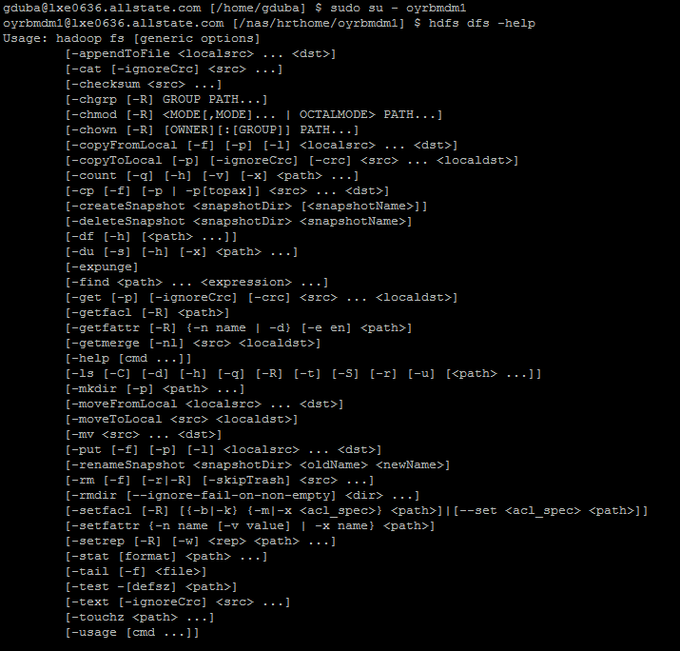
Hadoop basic commands
Link for Hadoop commands: https://hadoop.apache.org/docs/current/hadoop-project-dist/hadoop-common/FileSystemShell.html#cat

Slide 19
Different Data Storage Formats
JSON :
JSON: JavaScript Object Notation.
JSON is a syntax for storing and exchanging data.
JSON is text, written with JavaScript object notation.
Exchanging Data
When exchanging data between a browser and a server, the data can only be text.
JSON is text, and we can convert any JavaScript object into JSON, and send JSON to the server.
We can also convert any JSON received from the server into JavaScript objects.
This way we can work with the data as JavaScript objects, with no complicated parsing and translations.
Sending Data
If you have data stored in a JavaScript object, you can convert the object into JSON, and send it to a server:

Slide 20
Different data storage format Continues..
AVRO :
Apache Avro is a language-neutral data serialization system. Avro has a schema-based system. Avro is a preferred tool to serialize data in Hadoop.
A language-independent schema is associated with its read and write operations. Avro serializes the data which has a built-in schema. Avro serializes the data into a compact binary format, which can be deserialized by any application. Avro uses JSON format to declare the data structures.
Avro Schemas:
Avro depends heavily on its schema. It allows every data to be written with no prior knowledge of the schema. It serializes fast and the resulting serialized data is lesser in size. Schema is stored along with the Avro data in a file for any further processing.
In RPC, the client and the server exchange schemas during the connection. This exchange helps in the communication between same named fields, missing fields, extra fields, etc.
Avro schemas are defined with JSON that simplifies its implementation in languages with JSON libraries.

Slide 21
Different data storage format Continues..
Avro provides:
- Rich data structures.
- A compact, fast, binary data format.
- A container file, to store persistent data.
- Remote procedure call (RPC).
Simple integration with dynamic languages. Code generation is not required to read or write data files nor to use or implement RPC protocols. Code generation as an optional optimization, only worth implementing for statically typed languages.
Best Choice:
If your use case typically scans or retrieves all of the fields in a row in each query, Avro is usually the best choice. Best for Wide datasets.

Slide 22
Different data storage format Continues..
Parquet :
Apache Parquet is column oriented data serialization standard for efficient data analytics. Additional optimizations include encodings (RLE, Dictionary, Bit packing) and compression applied on series of values from the same columns give very good compaction ratios. When storing data on HDFS in Parquet format, the same partitioning strategy was used as in Avro case.
Apache Parquet is a free and open-source column-oriented data store of the Apache Hadoop ecosystem. It is similar to the other columnar storage file formats available in Hadoop namely RCFile and Optimized RCFile. It is compatible with most of the data processing frameworks in the Hadoop environment.
Best Choice:
If your dataset has many columns, and your use case typically involves working with a subset of those columns rather than entire records, Parquet is optimized for that kind of work.
It is best choice for Narrow datasets

Slide 23
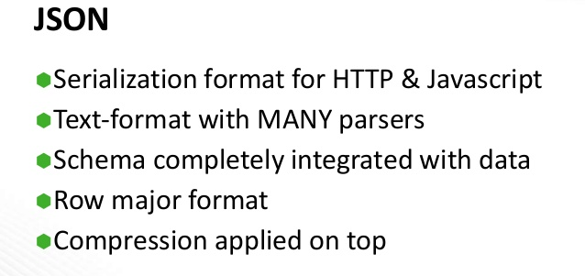
Uses Of JSON

Slide 24
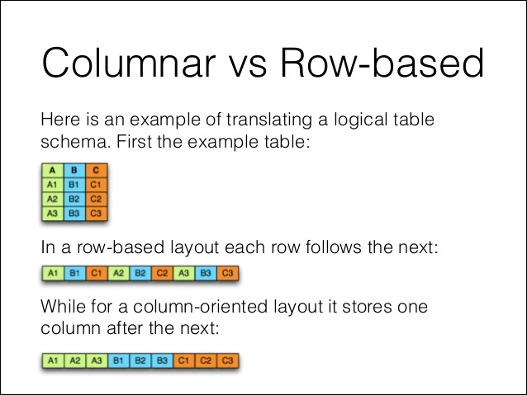
Avro VS Parquet when reading

Slide 25
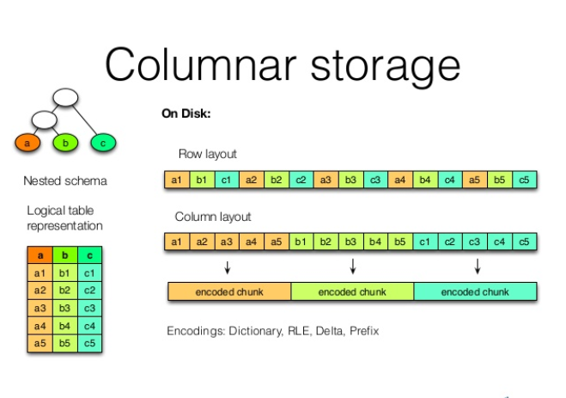
Example of columnar storage

Slide 26
Thank you

